Slide 1

The Slug Club Podcast:
Go to Market Strategy
Liz Achanta, 1/29/2020

Slide 2
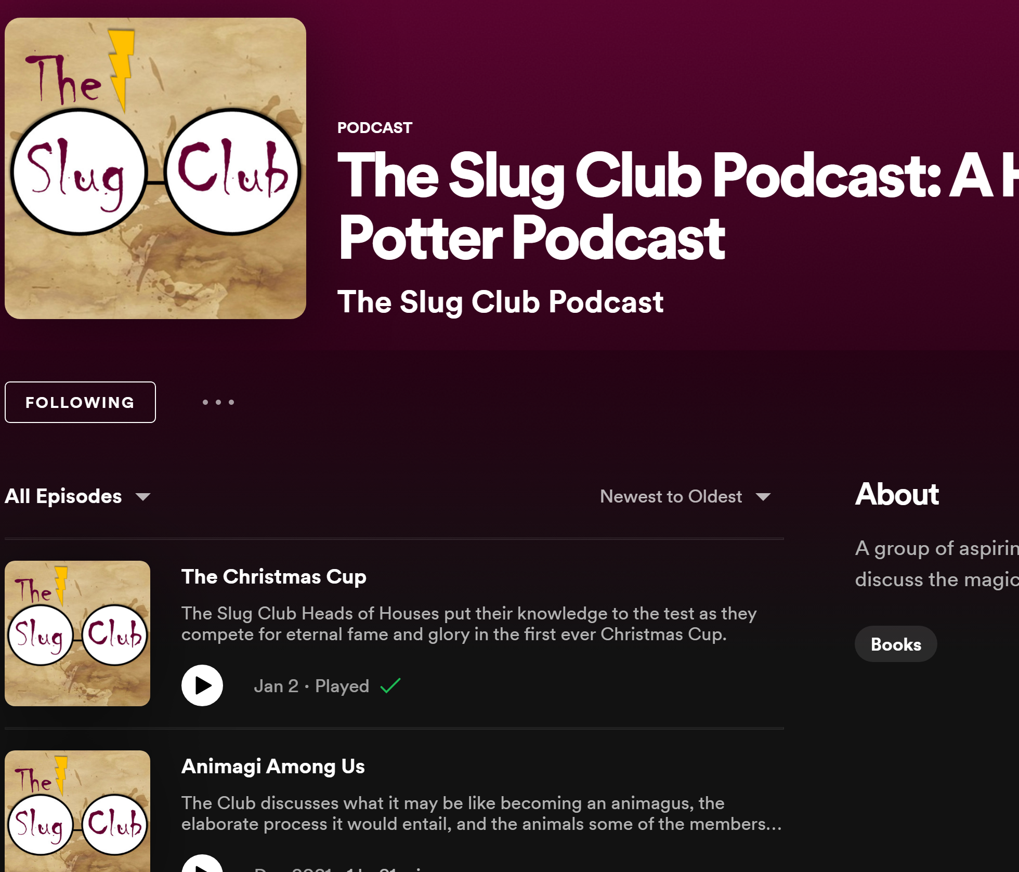
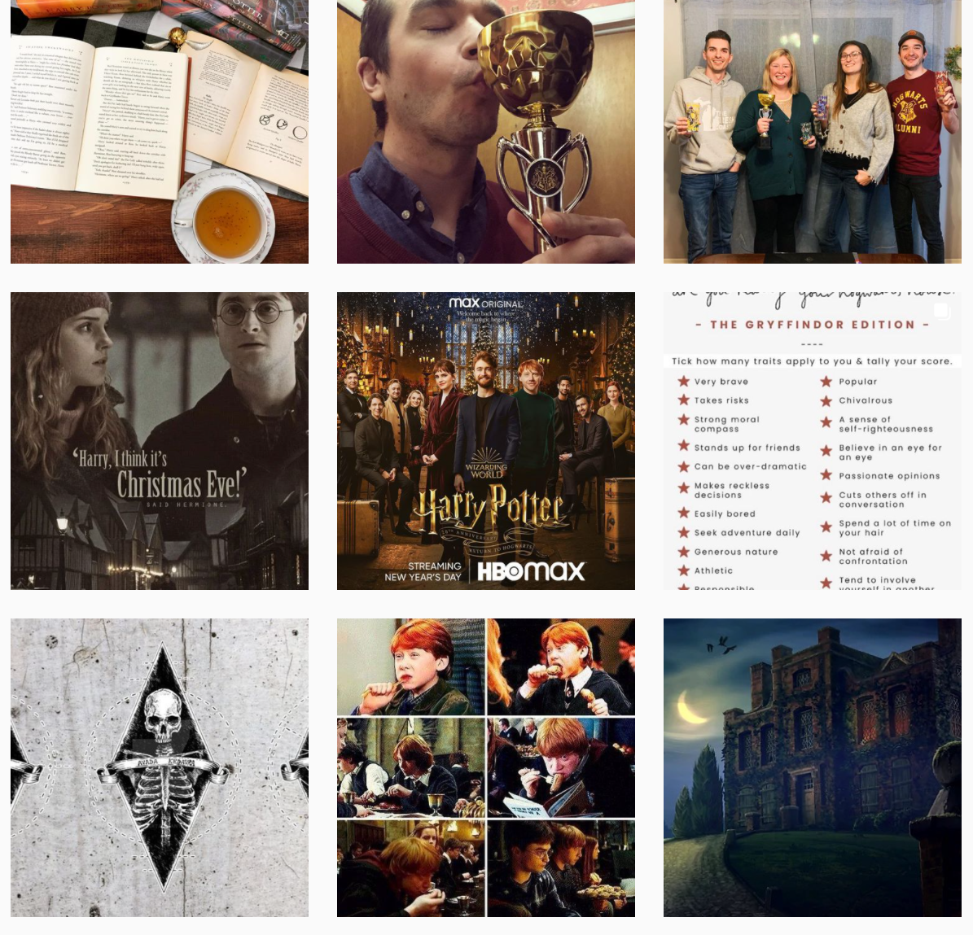
Contents
SWOT Analysis
Competitor Analysis
Podcast outreach
Website/Blog
Social Campaign

Slide 3
SWOT Analysis
Objective
To increase the reach of The Slug Club Podcast, branding us a thought leader and resource in the Harry Potter community.
Current State
Future State
14 podcast posts, 5-star review on Spotify, #X listeners, #X total downloads
There are many other Harry Potter podcasts, which impacts SEO & obtaining market share
Another podcast shares our name; considering TM for ownership
Post 2x/mo to increase following & engagement
Increased following and listening loyalty
Further promotion on Spotify via SEO
Remove other podcasters trying to utilize the same name
Threats
Opportunities
Legality/rights: will we receive pushback from Warner Bros?
Market share in the fan-based community is heavily saturated, with varying channels & creative measures
Ability to meet based on individual schedules
Rob’s inability to wait his turn to speak while someone else is
Originality in content: most podcasts are book read-throughs
18% of Americans are Harry Potter Fans, and 57% of the US listens to podcasts – ample room for growth

Slide 4
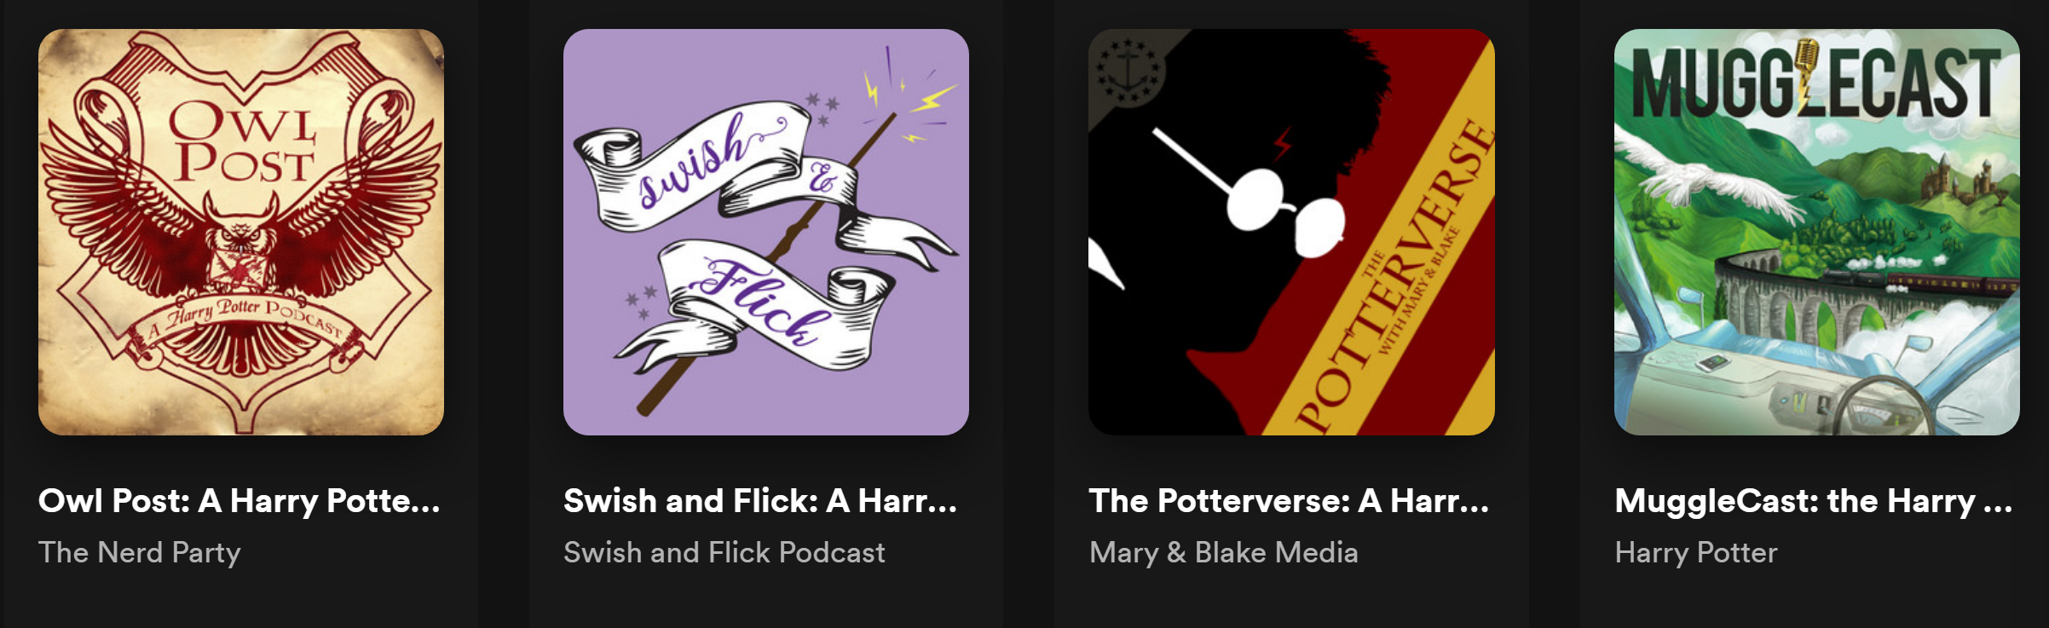
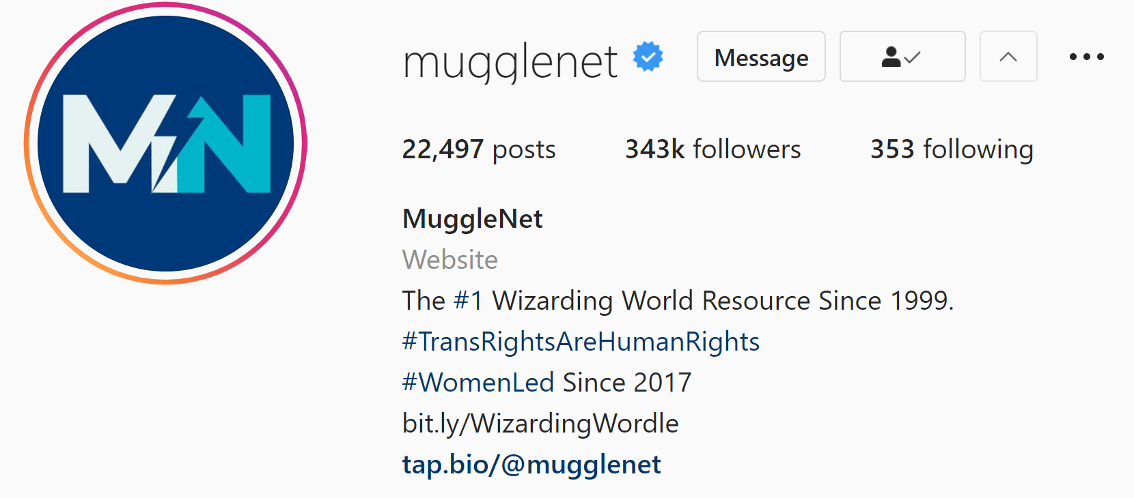
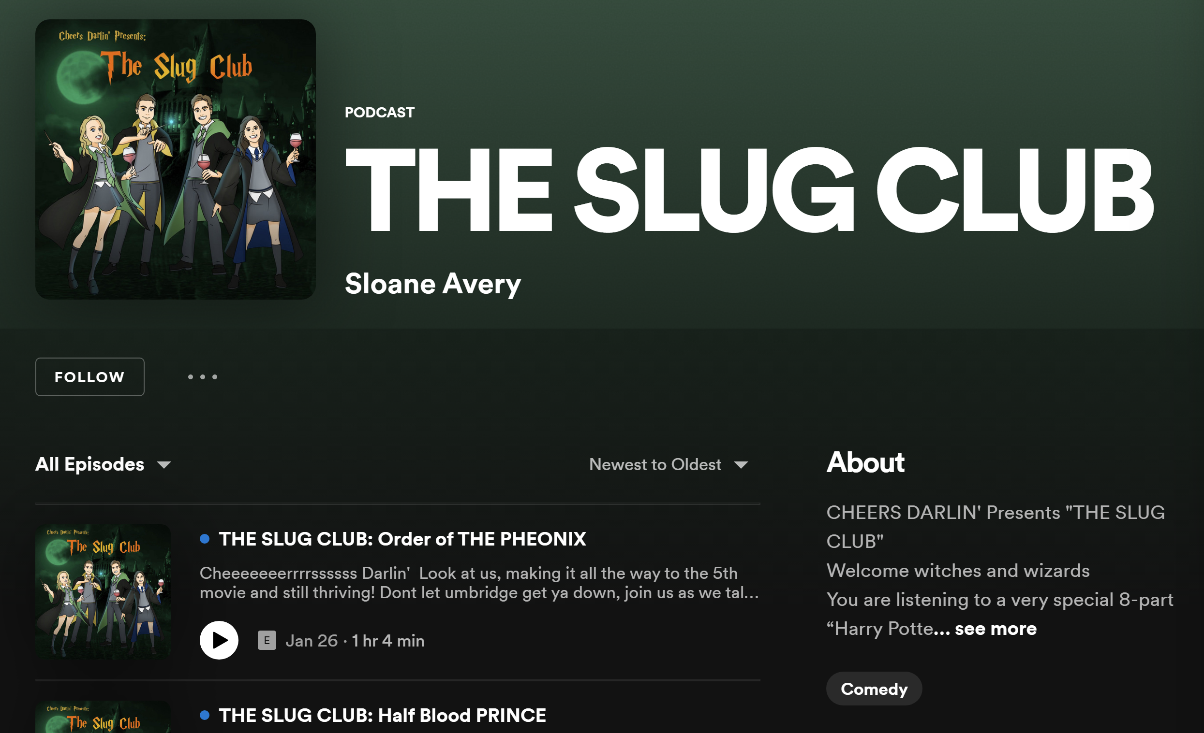
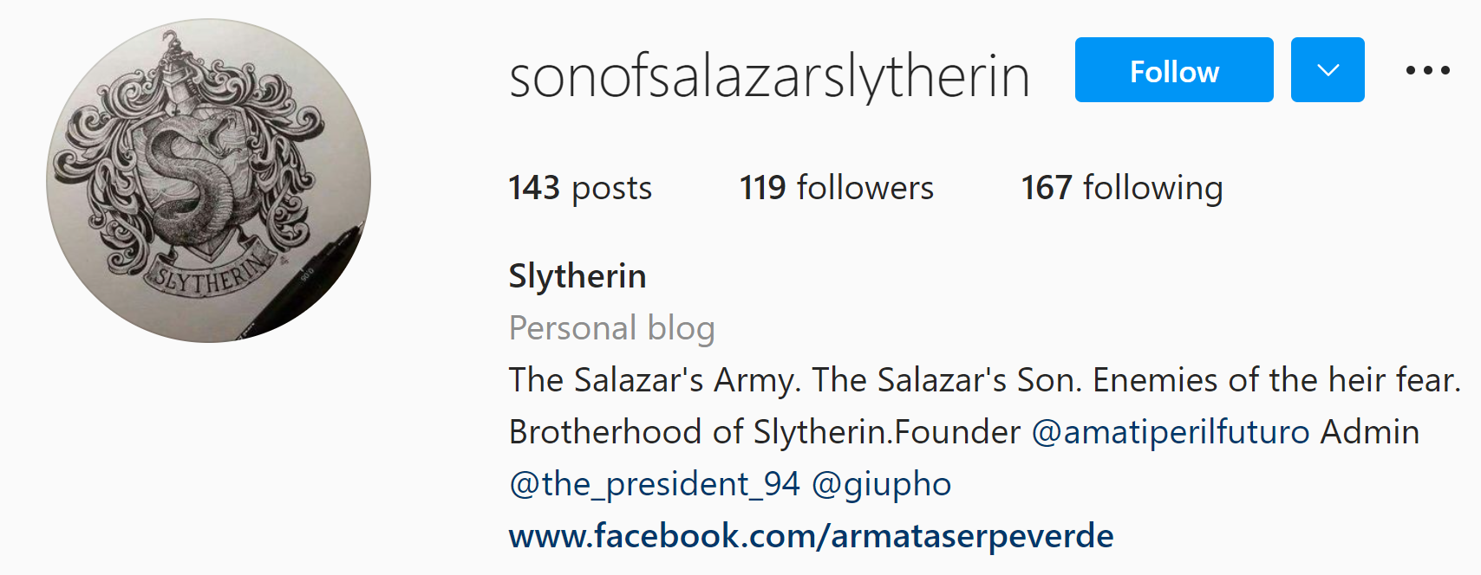
Competitor Analysis

Slide 5
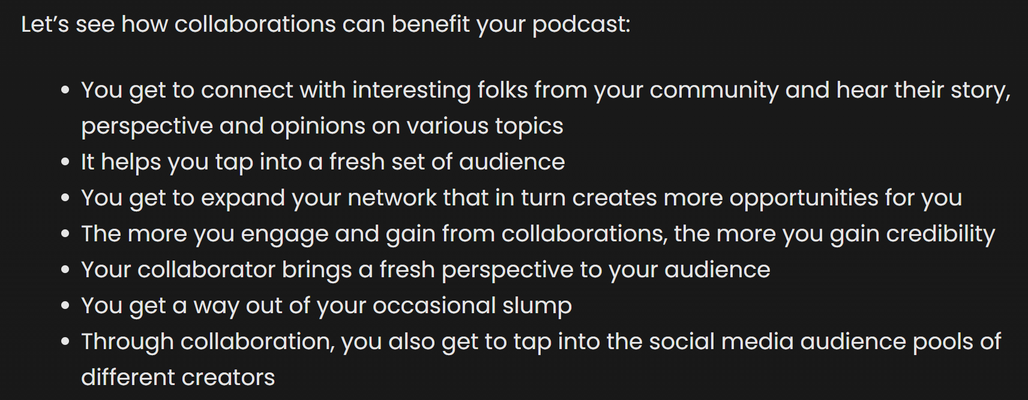
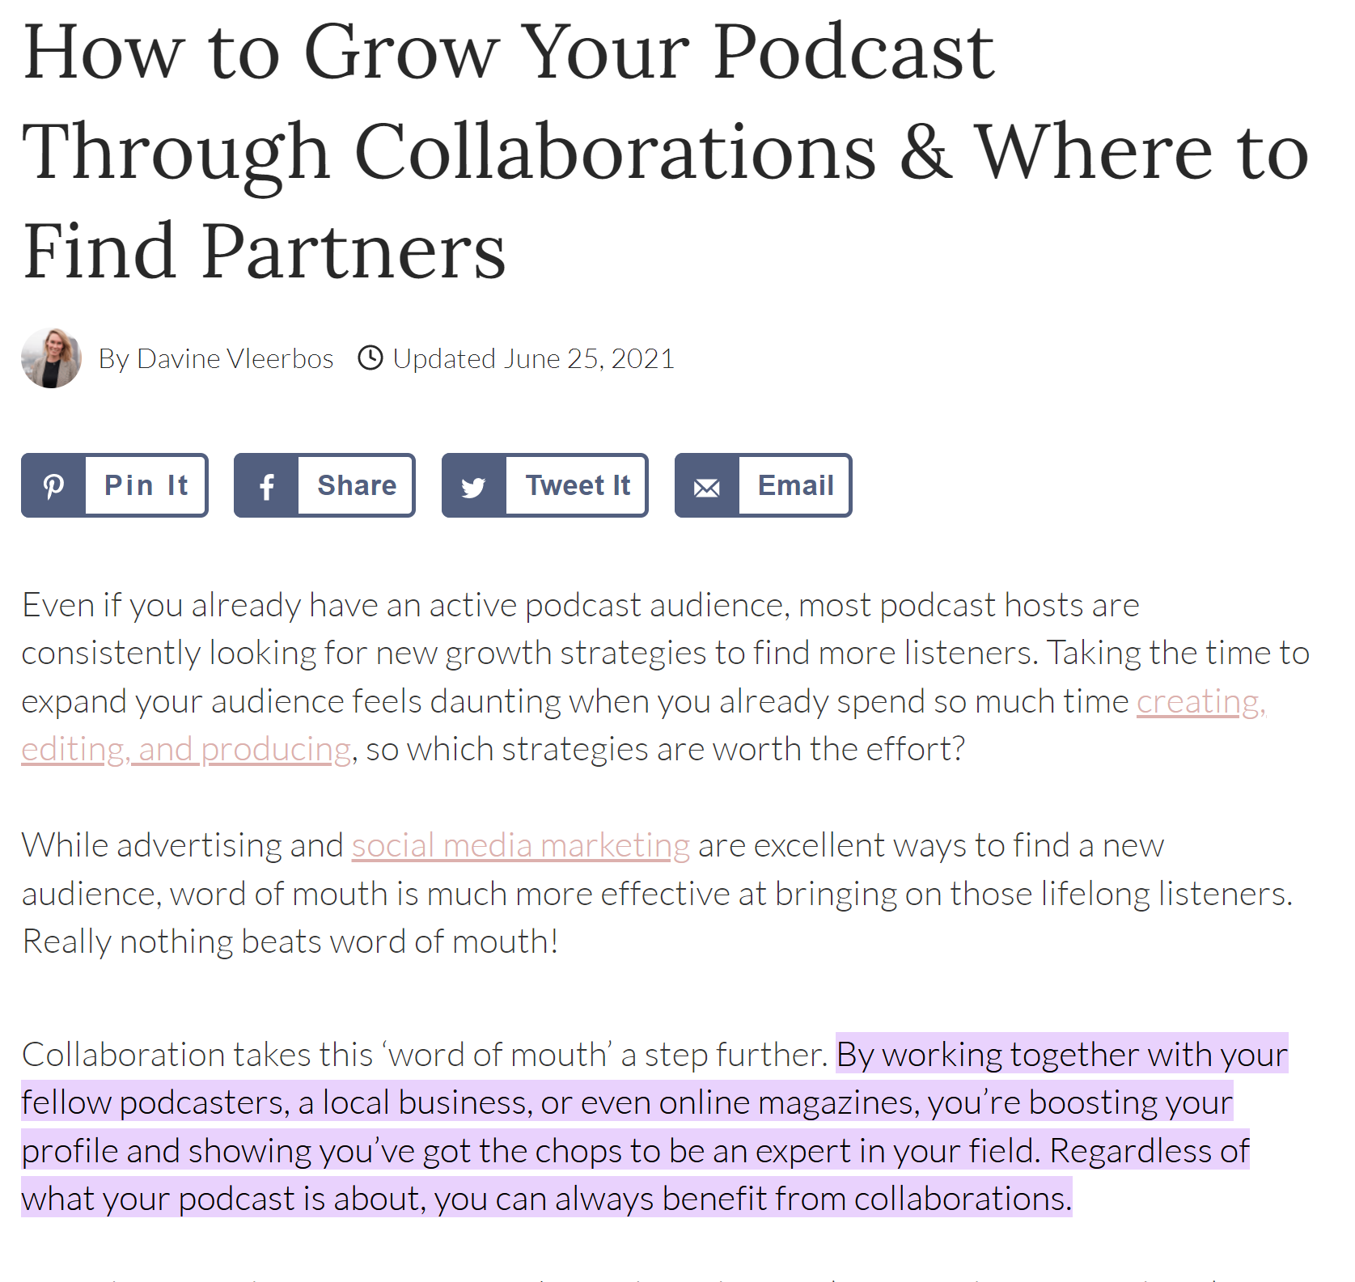
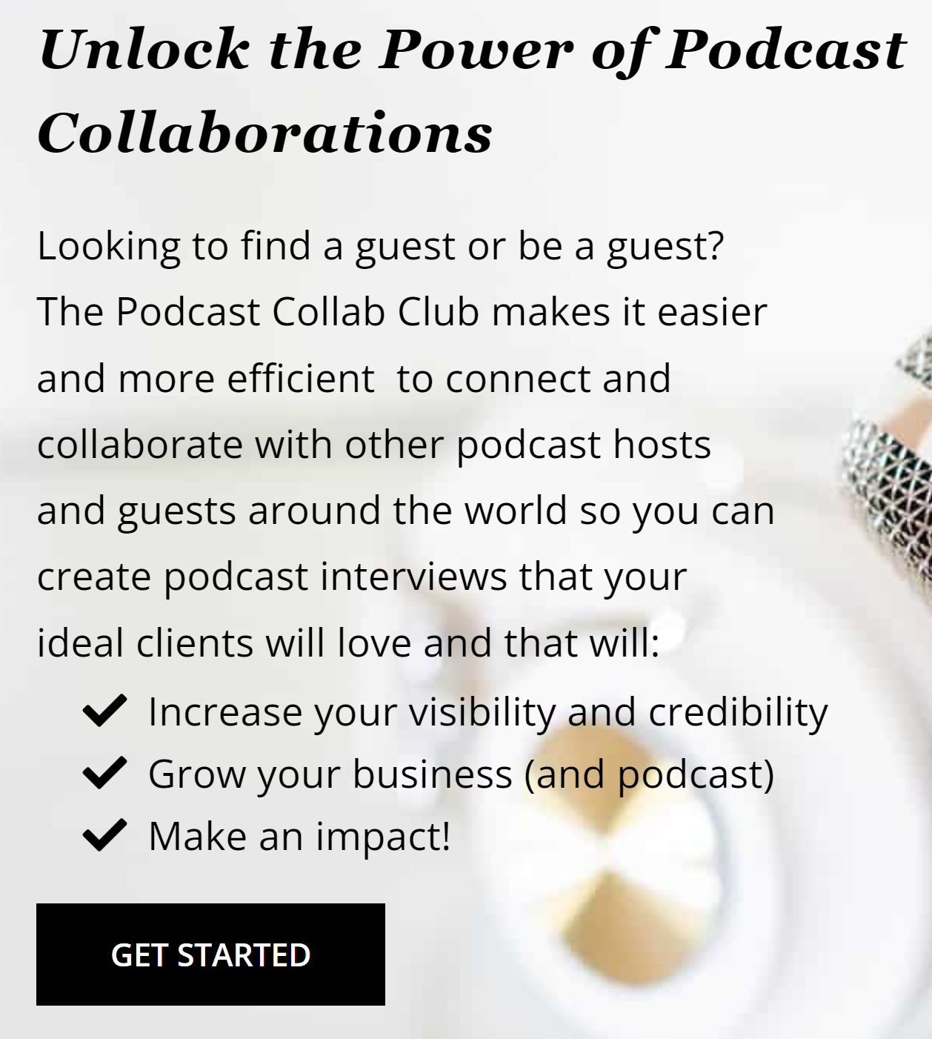
Podcast Outreach
Increase podcast posts to every-other week
  WE do not need to meet (the four of us) as a group for each post: e.g., we break into teams to host recurring series (who’s that magical creature, lesser-known characters in the magical world, etc.)
Collaborate with Others
  Have more ‘guest speakers’ who are well-known in the Magical Community
  Does not have to be with other podcasts; could have Instagram influencers, Bloggers, etc.

Slide 6
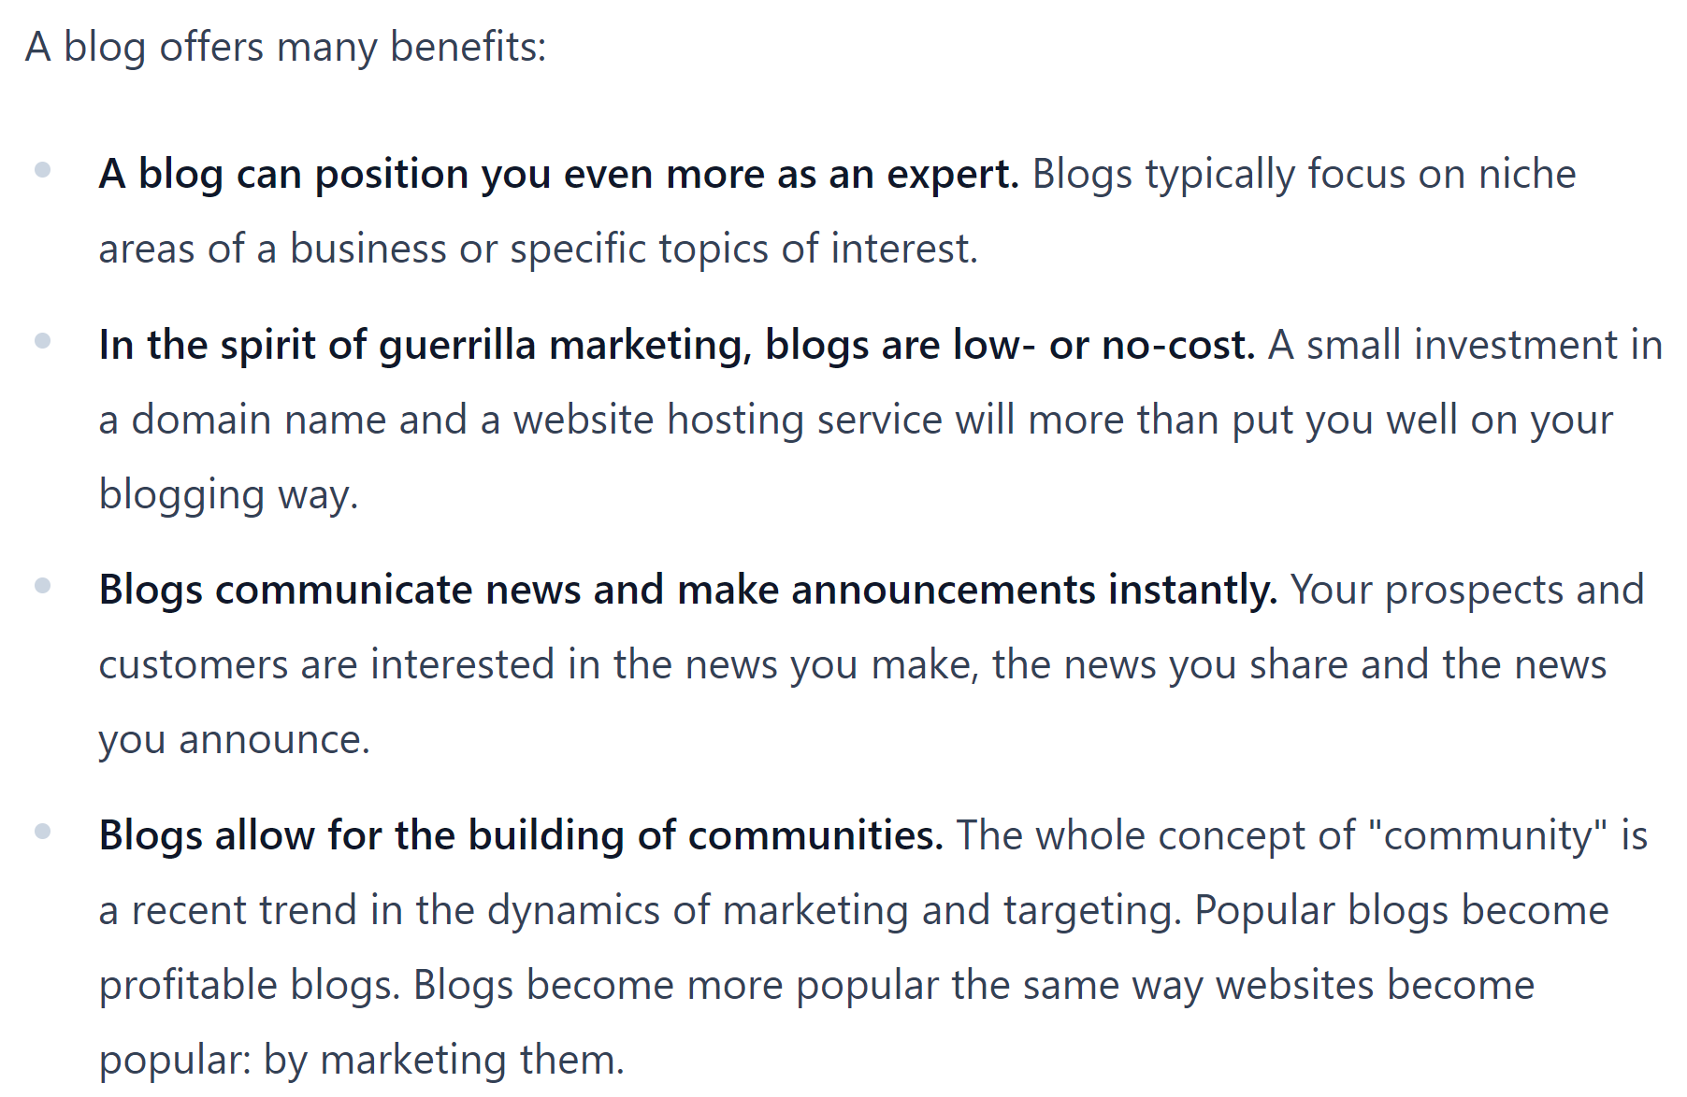
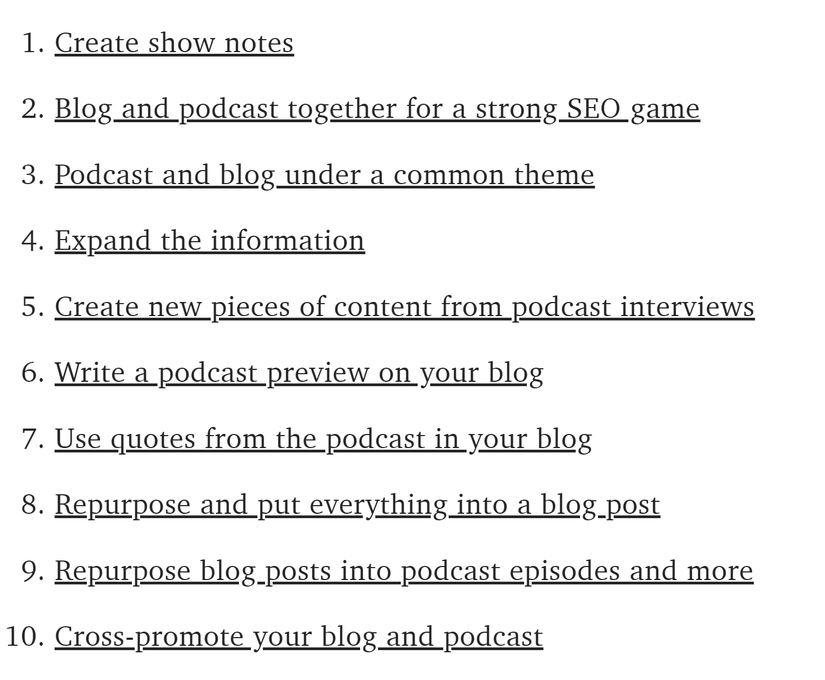
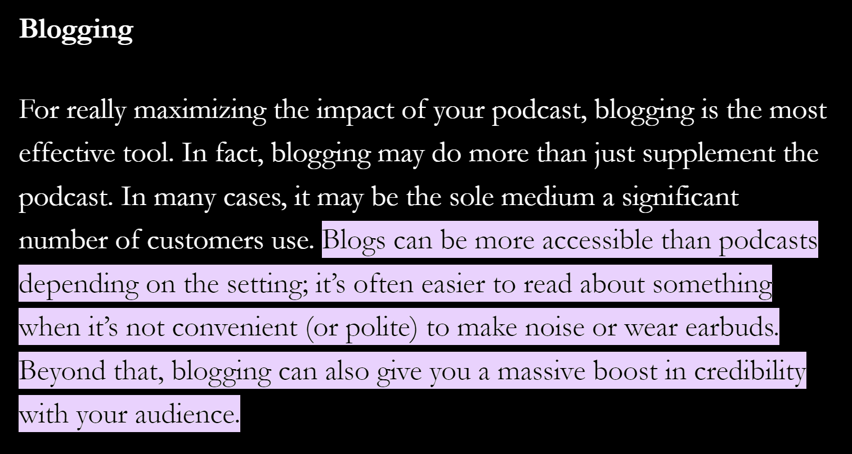
Website/Blog
SlugClubPodcast.Club
Blog Posts:
  Podcast Episodes (text version/overview, show charts with house points, etc. – promotes accessibility)
  Harry Potter Recipes/Vlog
  Harry Potter Crafts (downloadable)
    E.g., sew your own robe, quilting patterns, Rob’s 3D-design of the House Cup, etc. THESE WILL BE FREE
  Merchandise “The Slug Club”
    T-Shirts
    Stickers
    Mugs

Slide 7
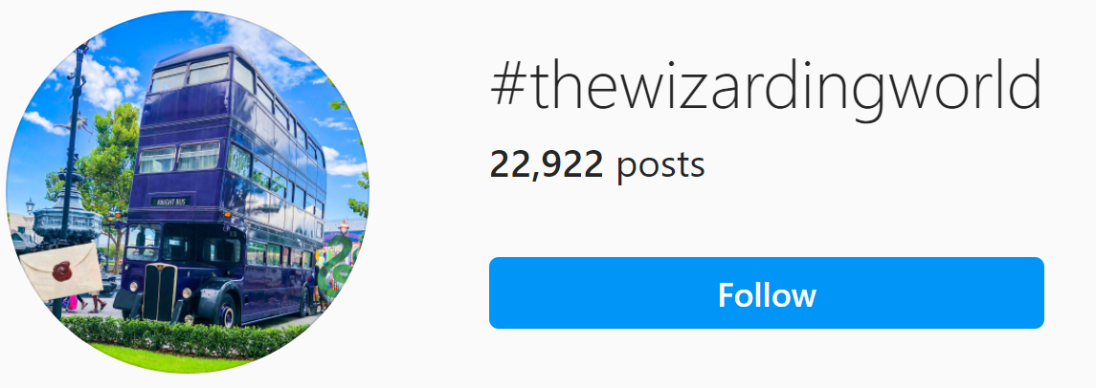
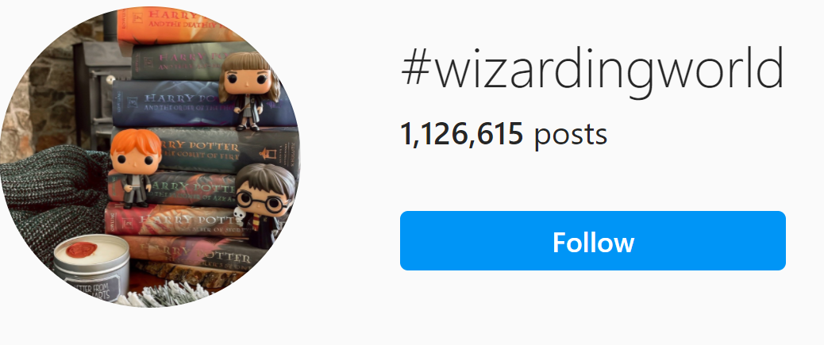
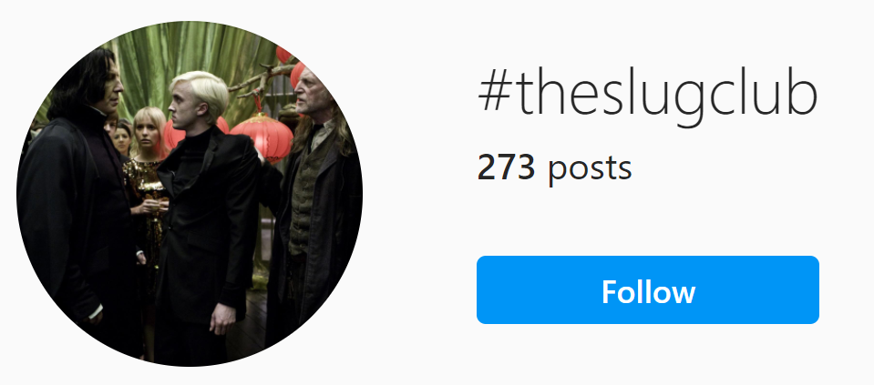
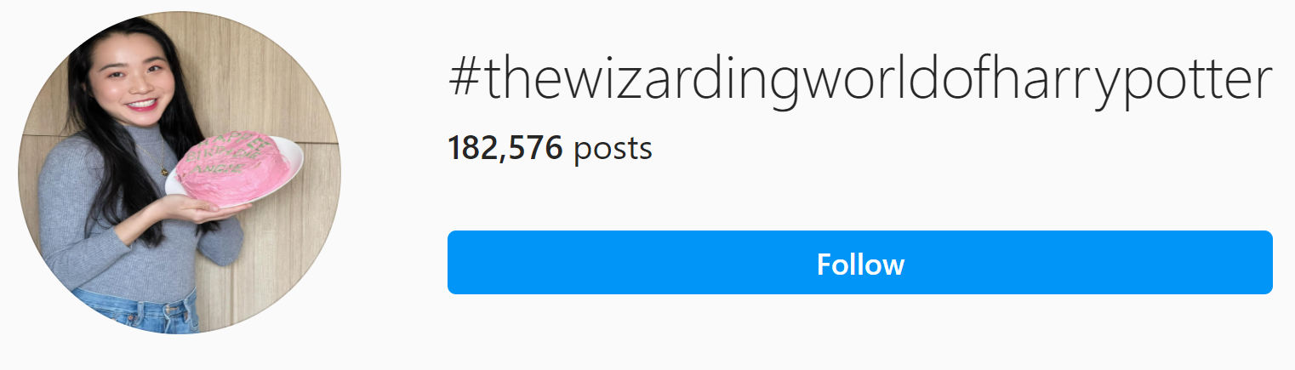
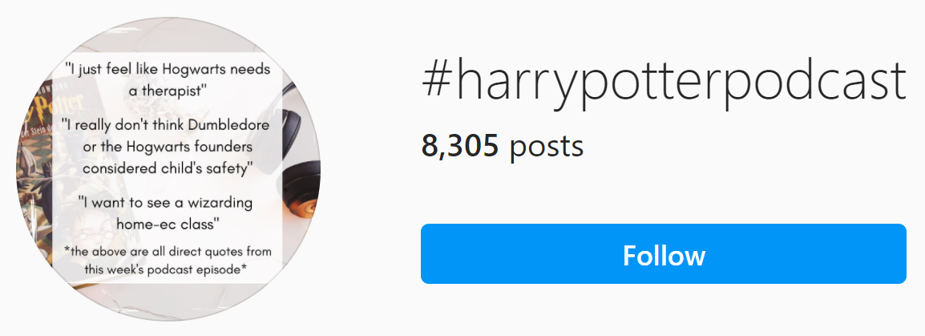
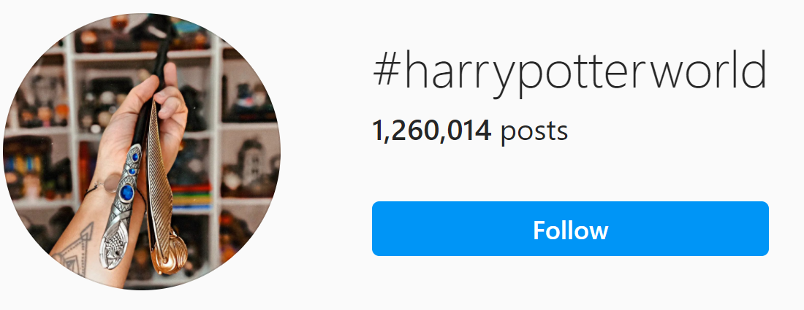
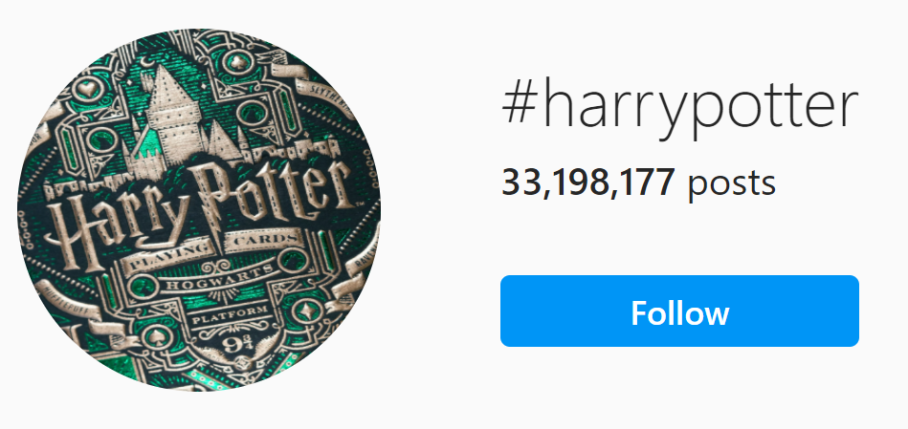
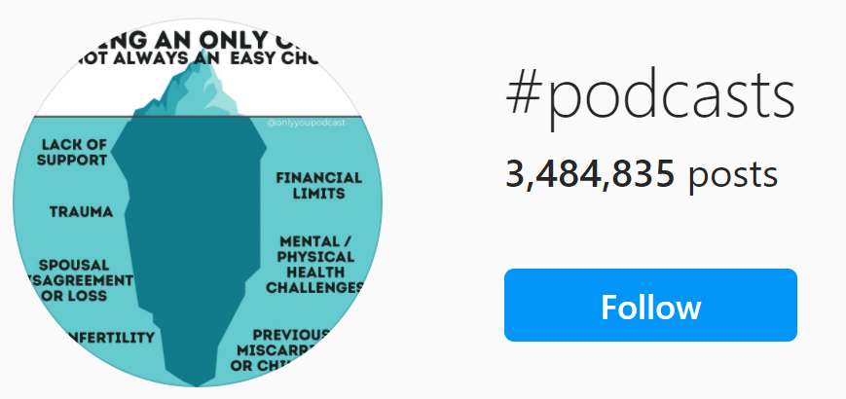
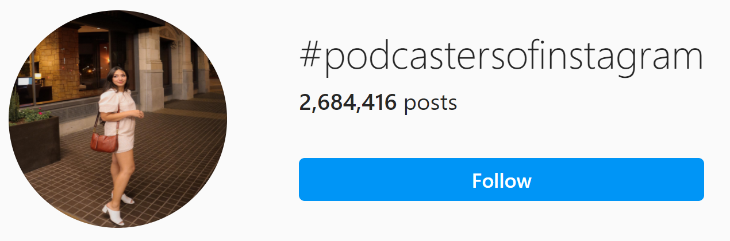
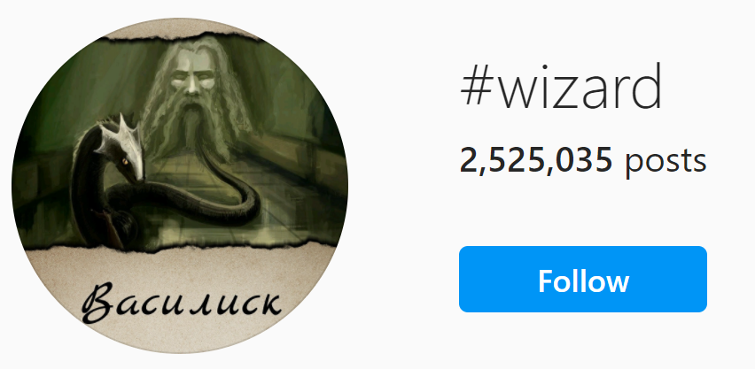
Social Campaign
Post more frequently: once per week
More original content, than re-posting
  Of our 26 posts, only 30% is original
Blog-related posts: promote each episode 3x/minimum (preview, ‘it’s published,’ ‘haven’t listened yet’), new recipe/craft, etc.
Slug Club member profiles: who we are, what we do in the Muggle World, our connection to HP/House/etc.
Feature other Instagram leaders on our site (affiliate marketing)

